Slide 5
Logan’s Landing
National and State Main Street Organization

Slide 6
Logan’s Landing Commercial Façade Improvement Program
Eligible Projects:
Exterior Painting
Awnings
Exterior Lighting
Front Facade Windows
Brick Façade
Façade Maintenance/Restoration
Eligible Applicants:
Commercial Properties
Owner or tenants
In the Downtown District
Not Delinquent on property taxes, City liens or fines
Not received maximum funding within last 4 years
Application on a rolling yearly basis
50% reimbursement up to $5,000
Need with application:
Current photograph of property to be improved
Project plans and specifications including description of improvements including materials and colors
Two preliminary estimates for scope of work from licensed contractor
Approval for Exterior Improvements from Planning Department

Slide 7
We are here

Slide 9
Logansport Redevelopment Commission
This Commission captures increases in taxable assessed value (AV), and then uses property tax revenue from these increases to fund improvements within the specified area.

Slide 10
Commercial Use Sidewalk/curbing Program
Eligible Projects:
Sidewalk
Curbs
Guttering
Eligible Applicants:
Within a Tax Increment Finance District (TIF)
Commercial Properties
Application on a rolling yearly basis
50% reimbursement up to $5,000
Need with application:
Approval from Board of Works (BOW) if within right-of-way
Approval from Logan’s Landing Design Committee if within Downtown
Approval from Planning Department
Estimate for scope of work

Slide 11
Exterior Improvement Program
Eligible Projects:
Exterior Doors
Painting
Shutters and Awnings
Signs
Stairs, Porches, Railing, Exit
Exterior Walls, Windows, Roofs
Walkways
Lighting
Parking lots
Eligible Applicants:
Within a Tax Increment Finance District (TIF)
Commercial Properties
Not Delinquent on property taxes, City liens or fines
Application on a rolling yearly basis
15% Forgivable Loan up to $250,000
Need with application:
Defined Scope of Work
Estimate(s) for scope of work
Approval for Exterior Improvements from Planning Department

Slide 13
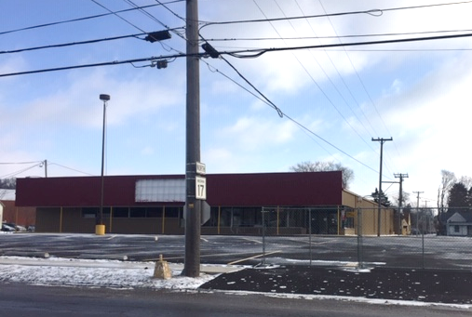
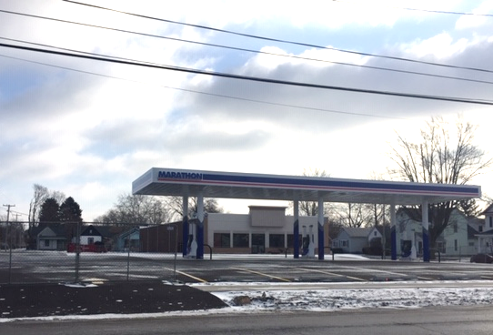
Exterior Improvement Program & Commercial Use Sidewalk/curbing Program
Gas Station & Convenience Store:
March 2019
Grocery : Timeframe has not been confirmed

Slide 14
Exterior improvement Program
Commercial space needs leased before the project will progress.
If needing Commercial Space call (765) 637-5815.

Slide 15
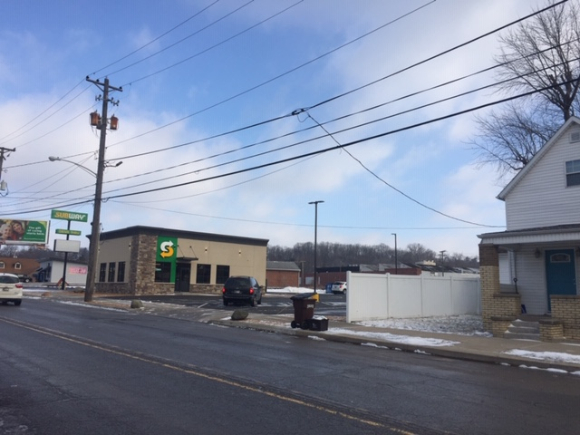
Exterior improvement Program
Now Open!!!!

Slide 16
Indiana Office of Community and Rural Affairs (OCRA)
Main Street Revitalization Program (MSRP)
&
Historic Renovation Grant Program (HRGP)

Slide 17
Main Street Revitalization Program (MSRP)
Eligible Projects:
Facades Renovations
Streetscape
Eligible Applicants:
City or Incorporated Town
Active Main Street Group
(Logan’s Landing)
Be an eligible activity under Community Development Block Grant (CDBG)
Completed Downtown Revitalization Plan within last 5 years
Application available twice a year
Minimum Local Match 20% of total project cost
Interested Building Owners must work with the City to:
Develop a scope of work and get environmental review approval for their building
Help provide match for project
Provide limited duration easement for Facade

Slide 18
Historic renovation grant program (HRGP)
Eligible Projects:
Roof replacement & rehab
Windows, doors, & historic entryways
Brick rehab & tuck pointing
Exterior foundation rehab
Rehab of Architectural Characteristics
Eligible Applicants:
Limited Liability Company,
Corporation, Individual, and/or
Nonprofit affordable housing organizations
Application on a rolling yearly basis
Local Match 65%
What is Historic
At least 50 years old
Registered Indiana Historic Site or Structure
Listed or eligible for National Register of Historic Places
Contributing resource to a National register District
Used & held for income purposes
A rental or other use for trade or business

Slide 19
Historic Districts map

Slide 20
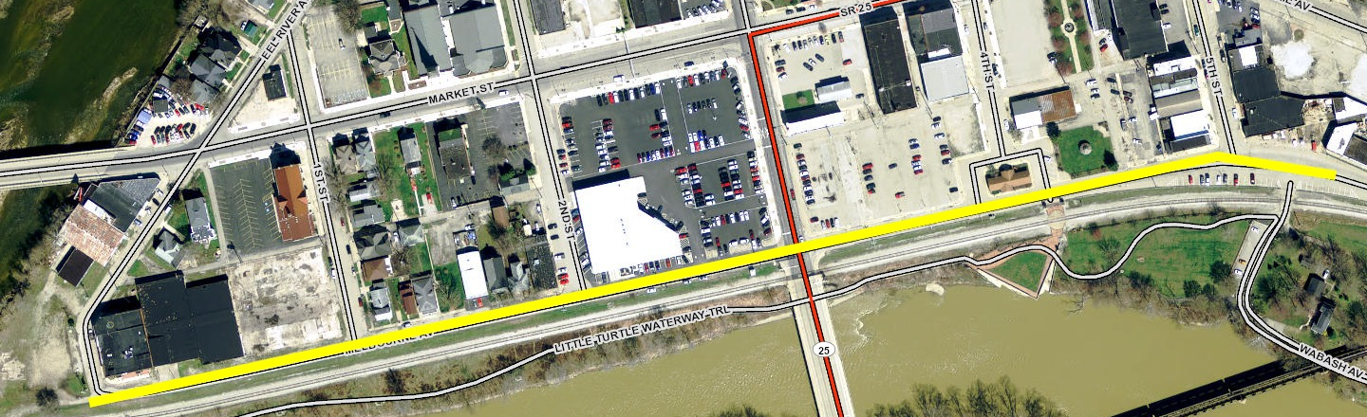
Melbourne Ave
LMU's multimillion-dollar Avenue wet weather (storm water) project,
scheduled to begin work by February 15, 2019
involves stacking two 10-foot diameter pipes under the roadway along Melbourne Avenue, from Eel River Avenue, east to 5th Street.
A pump station at 1st and Melbourne
Construction to take about two years
Melbourne Avenue will be closed
Intersection of 3rd Street and Melbourne scheduled after Market Street bridge re-opens

Slide 21
Market Street Bridge
The official completion date for the Market Street Bridge has been pushed back to late August 2019, due to a delay caused by relocation of a phone line. The bridge remains closed to vehicle and pedestrian traffic.

Slide 22
4th and 5th St.
Bids for converting 4th and 5th Streets in downtown Logansport from one-way to two-way came in unexpectedly high, and the Logansport City Council has put the project on hold.

Slide 23
Reimagine this Space
Imagine Creating a Larger Outdoor Event Venue
Would features such as :
Pavilions,
Stage,
Expanded Farmer’s Market,
Seating,
Artwork,
More Trail and Sidewalk Connections,
Free Wi-Fi,
Open Restrooms,
Commercial kitchen, and
Others
be important to you in a Community Park in Downtown

Slide 24
Q&A
Representatives are available:
Becki Harris from Logan’s Landing;
Suzanne Chilcott with Redevelopment Commission; and
Steven Ray w/ North Central Indiana Planning Council
If interested in these programs please go to www.cityoflogansport.org and the form will be on the front page or you can get a hard copy in the Mayor’s Office.
All forms must be returned to the Mayor’s Office or filled out online by Feb. 27, 2019
This presentation will also be available next week on www.cityofloganport.org.

