Slide 1
State of the City 2019
Forward. Thinking. Progress. 1.3

Slide 2
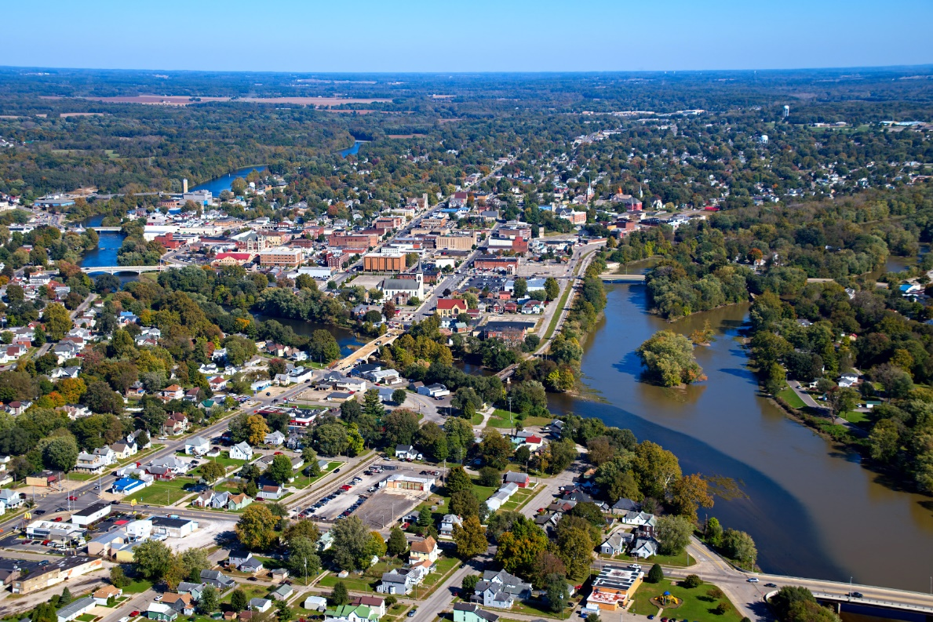
Once in a blue moon, something great happens.
“Logansport named the No. 1 small town in America where you’d actually want to live” by Realtor.com

Slide 3
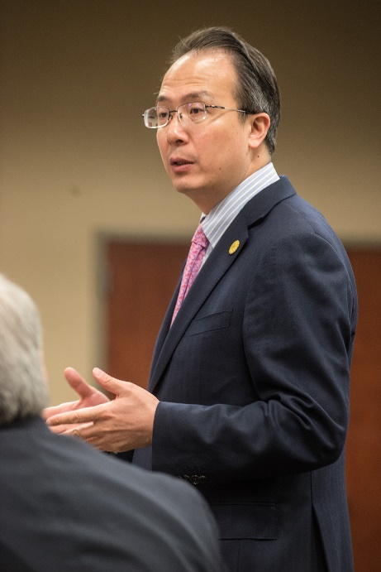
Economic development
Logansport’s unemployment rate at 3.7 percent, lower than Howard, Miami counties; equals state rate
Since re-stablishing CLEDO/city relationship, $135 million in investment in economic growth, with 300 new jobs
Electric rates drop 10 percent
Economic development electric rate set
Tyson payroll up from $68 million to $82 million
Meetings with Chinese delegation, consulate

Slide 4
Supermarket sweepstakes
Aldi’s expands, renovates
Marsh on North Third sold, redeveloped
Marsh on 14th Street sold

Slide 5
Local economy
Black Dog, Legacy Outfitters opens
Dollar General added
Heartland investment
Letter of intent to purchase mall
Osborn Auto World
Partridge’s sold
Zip-Thrus, Phillips 66 sold
Ten downtown businesses open, three close; net gain of 47 jobs

Slide 6
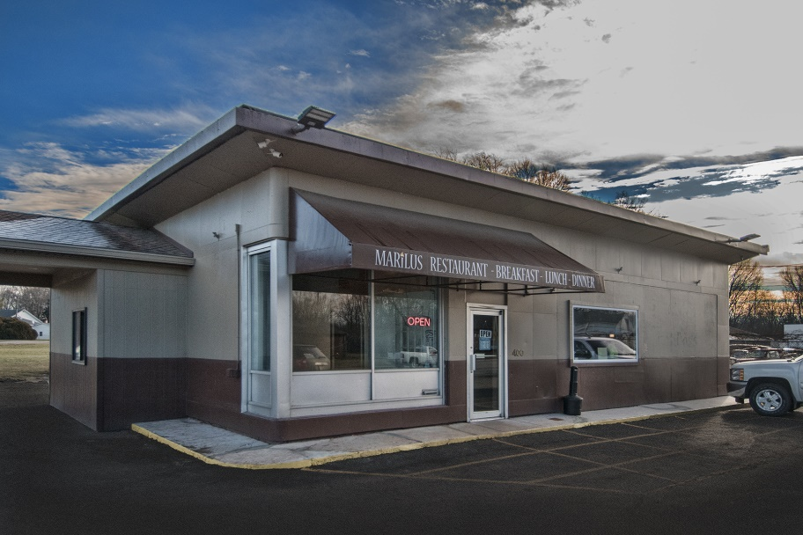
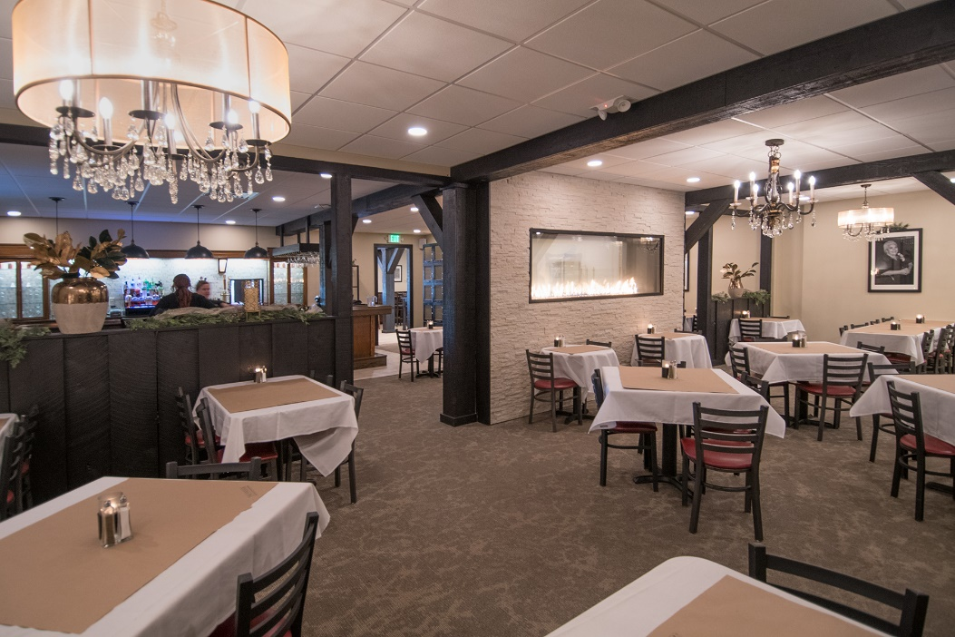
Our table is ready
Burger King relocation
Mariscos Acapulco
Marilu’s
Shively’s BBQ
The Fireside

Slide 7
Workforce
Secretary of Career Connection and Talent visits Logansport
Skillful Indiana initiative
Ivy Tech appoints workforce contacts
Advanced Manufacturing Night

Slide 8
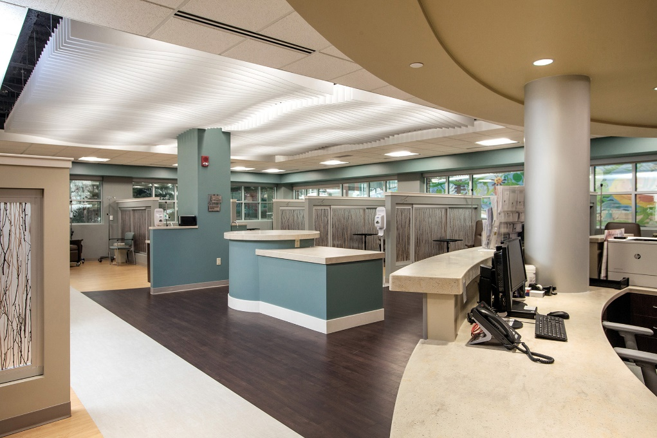
Benchmarks
Cole family donates $1 million to $3.7 million Y renovation
Memorial Hospital opens $7 million cancer center
Logansport named “A” High School
Logansport ranked 10th safest city in state

Slide 9
Housing
Housing master plan calls for 400 units
ReVere Homes project approved by state
Logan Square now leasing apartments
Trelleborg Subdivision approved

Slide 10
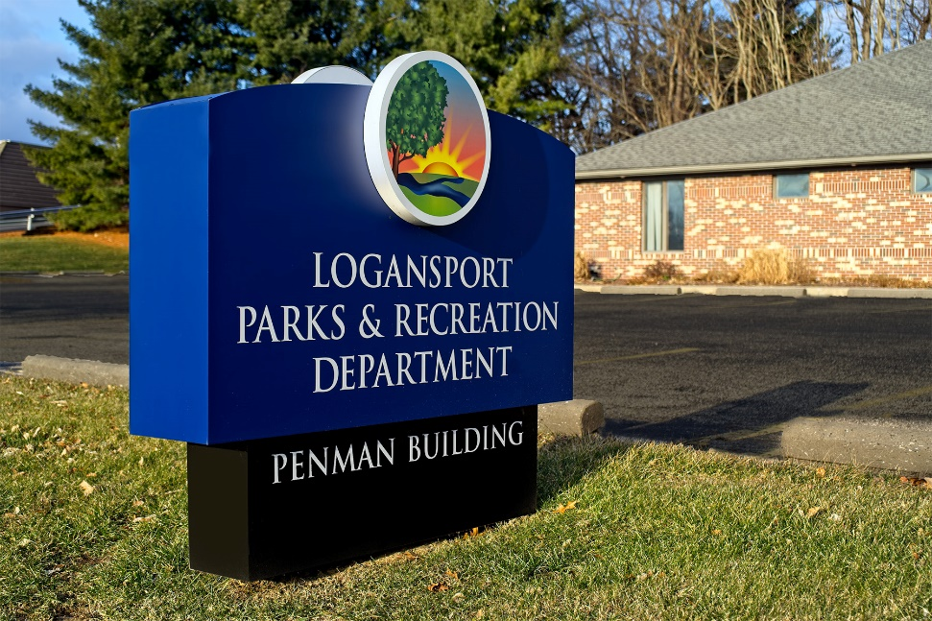
City parks
New restrooms at Riverside
City receives second outdoor fitness grant for Indiana
Parks master plan approved
Spencer restrooms approved

Slide 11
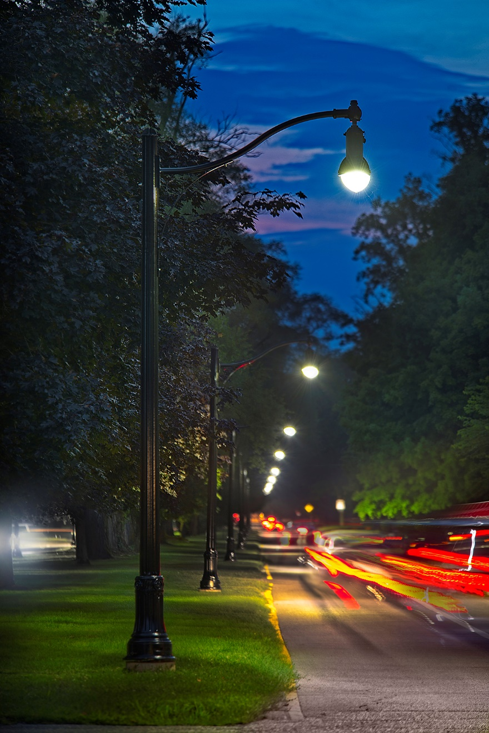
Street Department
Paving totals 5.47 miles (65 blocks)
25 ADA intersections
Fulton Street sidewalk
Worst leaf season ever filled 304 dump truck loads of leaves and 125 leaf Vac loads

Slide 12
LMU
Utilities turns from $7 million in red to plus $3 million in one year
Stormwater project approved
Rates approved for water, wastewater
New rate structures places Logansport among cities with lowest rates in state
Depreciation of LMU system funded

Slide 13
Financially speaking
2018 General Fund:
Up $675,645 to $5,030,204 (13 %)
Increased $2,072,263 in three years (49 %)
TIF Funds:
Up $111,823 to $16,280,963
Increase $921,576 in three years
CEDIT balance
Down $136,044 to $2,910,581
Increase $488,172 in three years
Grand Total w/o LMU:
Down $1,183,375 from 2017
Increase $2,738,675 in three years (13.5 %)
Interest Income:
Up $44,549 (7.9 %)
Increase $502,876 in three years
Total budgeted funds unspent:
8 % ($1,263,598)

Slide 14
Public Safety
Police answered 11,430 calls, made 8,558 traffic stops and 1,467 arrests (additional 1,119 citations)
Answered 461 calls in the city limits
City joined state opioid class action lawsuit
Joint task force investigated 276 cases and made 180 arrests
Six task force efforts led to another 21 arrests
135 methamphetamine investigations, 65 marijuana/synthetic durg investigations, 22 heroin investigations and nine cocaine investigations
Animal warden responded to 461 calls in the city, 355 in rural Cass County

Slide 15
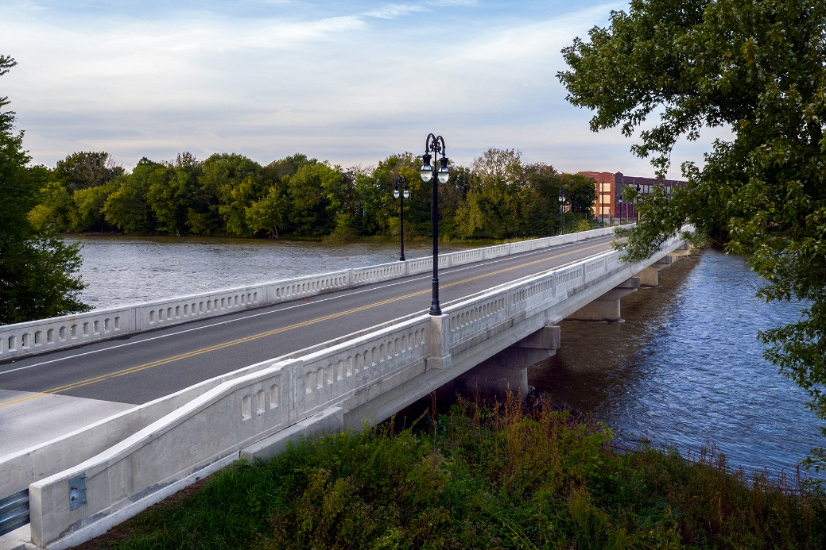
Construction
Total projects – 891
Fees collected -- $63,094
Project costs -- $12,966,654

Slide 16
Cemetery
Revenue of $111,480
Street sign replacement
Convert to LED lighting
Street paving
Wreaths Across America

Slide 17
Code Enforcement
Violations dropped from 851 to 795
Cleared violations rose from 675 to 685
Violations cleaned by city increased from 155 to 158
City towed more vehicles (up 4 over 2017) and owners cleared more vehicles (up 15)
443 notices sent to property owners (up from 378), but violations cleared by owners also were up (303/300)
Yards mowed by the city up (147 to 124)

Slide 18
The 19 for ‘19
Implement Housing Master Plan; meet demand for 400 new units
Elevate our economic development efforts nationally to attract higher-paying jobs investment; pursue Opportunity Zone
Expand work force candidate pool through state initiative
Infrastructure improvements (paving with Community Crossings funds, streetlights on Heartland entrance, fire hydrants)
Pursue fiber possibilities for areas not served in the city
Actively address public health issues in the community
Prepare for an accurate U.S. Census count in 2020
Work on trash proposals, including the possible creation of our city sanitation department and the elimination of the trash tax

Slide 19
The 19 for ‘19
Create an Adopt-A-Spot program for city properties
Transparency portal for city finances
Riverside Historic District application
Continue improvements in energy efficiency
Development of Wabash Heartland Innovation Network
Re-establish a business plan/entrepreneur competition
Establish a youth council
Mall, Trelleborg and Memorial Center redevelopment
Riverside Park master plan
Recodification of city ordinances
Celebrate Felix the Cat’s 100th, Dentzel centennial

Slide 20
Our philosophy
Logansport is only a word until a community gives it meaning.

Slide 21
In 2019, Logansport is in a state of purpose-driven, ambitious momentum.

